Slide 1
Network Visualization
Sougata Mukherjea
IIT Delhi

Slide 2
Network Visualization
Introduction to Visualization
Graph Visualization
Graph Layout
Tree Visualization
Interaction
Graphical Excellence
Network Visualization Software

Slide 3
Network Visualization
Introduction to Visualization
Graph Visualization
Graph Layout
Tree Visualization
Interaction
Graphical Excellence
Network Visualization Software

Slide 4
What is Visualization?
The purpose of visualization is to convey information to
people through graphical representations of data.
Visualization has previously been defined as the “Formation of visual images; the act or process of interpreting in visual terms or of putting into visual form"
More recently a new definition has been added: "A tool or method for interpreting image data fed into a computer and for generating images from complex multi-dimensional data sets"
A cognitive process
Form a mental image of something
Internalize an understanding
The use of computer-supported, interactive visual representations of data to amplify cognition - Card, Mackinlay Shneiderman

Slide 5
History of Visualization
Visualization, in the presentation sense, is not a new phenomenon.
It has been used in maps, scientific drawings, and data plots for over a thousand years.
Most of the concepts learned in devising these images carry over in a straight forward manner to computer visualization
Computer Graphics has from its beginning been used to study scientific problems. However, in its early days the lack of graphics power often limited its usefulness.
With advances in the Computer Hardware the ability to create useful computer visualization has increased.
Dozens of companies – including Google, Microsoft, IBM, Oracle and SAP – offer visualization tools.
Thousands of companies and governments use the tools for daily operations and for longer-term strategic planning.

Slide 6
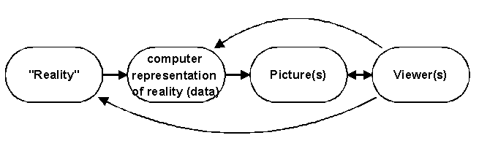
Basics of Visualization
Visualization is essentially a mapping process from computer representations to perceptual representations, choosing encoding techniques to maximize human understanding and communication. The goal of a viewer might be a deeper understanding of physical phenomena or mathematical concepts, but it also might be a visual proof of computer representations derived from such an initial stage.
“The purpose of visualization is insight, not pictures”
Insight: discovery, decision making, explanation
“Visualization is really about external cognition, that is, how resources outside the mind can be used to boost the cognitive capabilities of the mind.” - Stuart Card, Xerox PARC

Slide 7
Visualization Goals
Record information
Blueprints, photographs, seismographs, …
Analyze data to support reasoning
Understand your data better and act upon that understanding
Develop and assess hypotheses (visual exploration)
Find patterns and discover errors in data
Presentation – Communicate and inform others more effectively
Share and persuade (visual explanation)

Slide 8
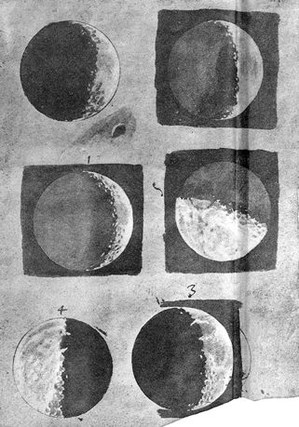
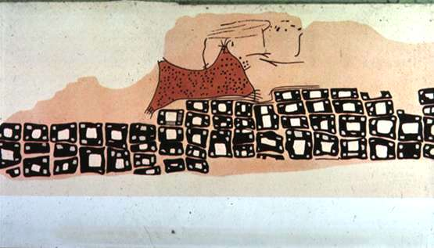
Record
Konya town map, Turkey, c. 6200 BC
Galileo Galilei, 1616

Slide 9
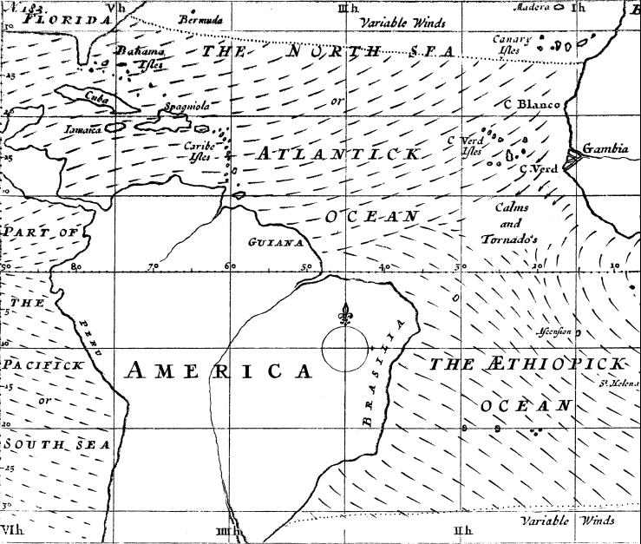
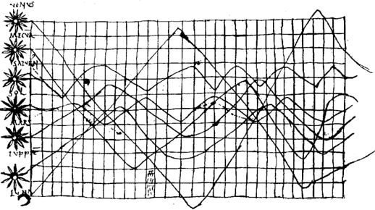
Analyze
Planetary Movement Diagram, c. 950
Halley’s Wind Map, 1686

Slide 10
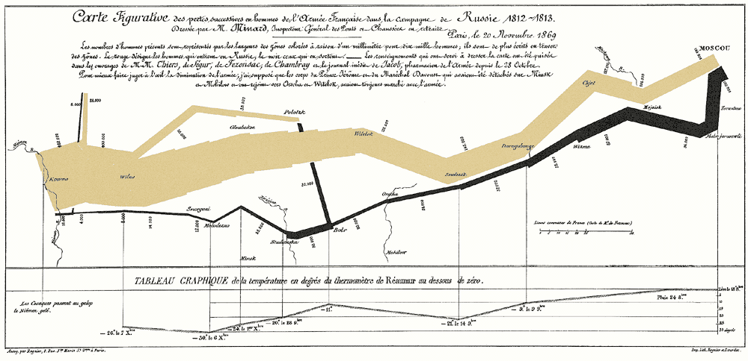
Communicate
Napoleon's invasion of Russia in 1812, by Jacque Minard

Slide 11
When to apply Visualization?
Visualization most useful in exploratory data analysis
Don’t know what you’re looking for
Don’t have a priori questions
Want to know what questions to ask
Search (OK)
Finding a specific piece of information
Browsing (Better)
Look over or inspect something in a more casual manner, seek interesting information
Visuals can frequently take the place of many words
Visuals can summarize, aggregate, unite, explain, …
Sometimes words are needed, however

Slide 12
Challenges of Information Visualization
Visual Representation: Designing a cognitively useful spatial mapping of a dataset that is not inherently spatial and accompanying the mapping by interaction techniques that allow people to intuitively explore the dataset
Scale of data: Challenge often arises when data sets become large
Diversity: Data of data types, forms, sizes

Slide 13
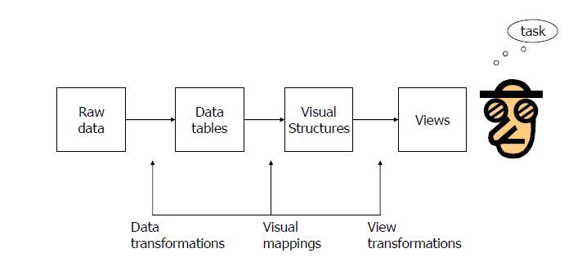
Information Visualization Processing Model
“The effectiveness of information visualization hinges on two things: its ability to clearly and accurately represent information and our ability to interact with it to figure out what the information means.”
S. Few, Now you see it

Slide 14
Visual Analytics
Visual analytics is the science of analytical reasoning facilitated by interactive visual interfaces
Visual analytics combines automated analysis techniques with interactive visualizations for an effective understanding, reasoning and decision making on the basis of very large and complex data sets

Slide 15
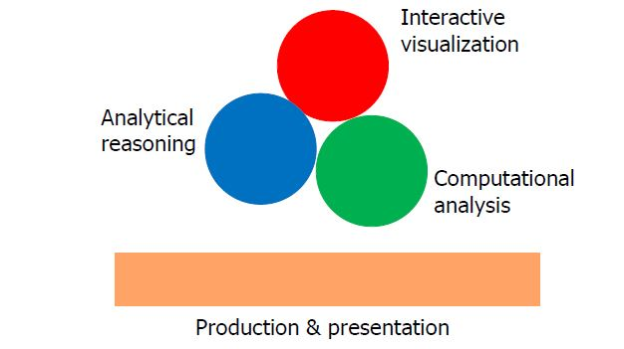
Visual Analytics – Main Components

Slide 16
Network Visualization
Introduction to Visualization
Graph Visualization
Graph Layout
Tree Visualization
Interaction
Graphical Excellence
Network Visualization Software

Slide 17
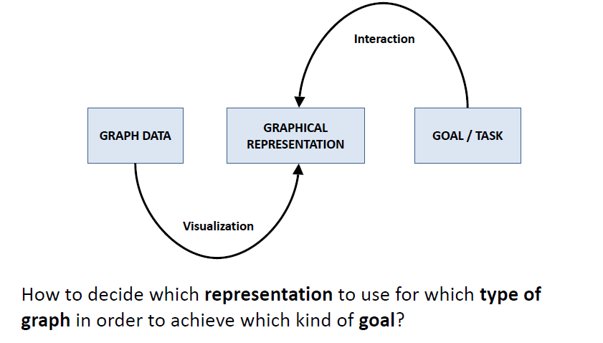
Graph Visualization

Slide 18
Different Kinds of Tasks/Goals
Two principal types of tasks: attribute-based (ABT) and topology-based (TBT)
Localize – find a single or multiple nodes/edges that fulfill a given property
ABT: Find the edge(s) with the maximum edge weight.
TBT: Find all adjacent nodes of a given node.
Quantify – count or estimate a numerical property of the graph
ABT: Give the number of all nodes.
TBT: Give the indegree (the number of incoming edges) of a node.
Sort/Order – enumerate the nodes/edges according to a given criterion
ABT: Sort all edges according to their weight.
TBT: Traverse the graph starting from a given node.

Slide 19
Shneiderman’s Graph Visualization Nirvana
Every node is visible
For every node you can count its degree
For every link you can follow it from source to destination
Clusters and outliers are identifiable

Slide 20
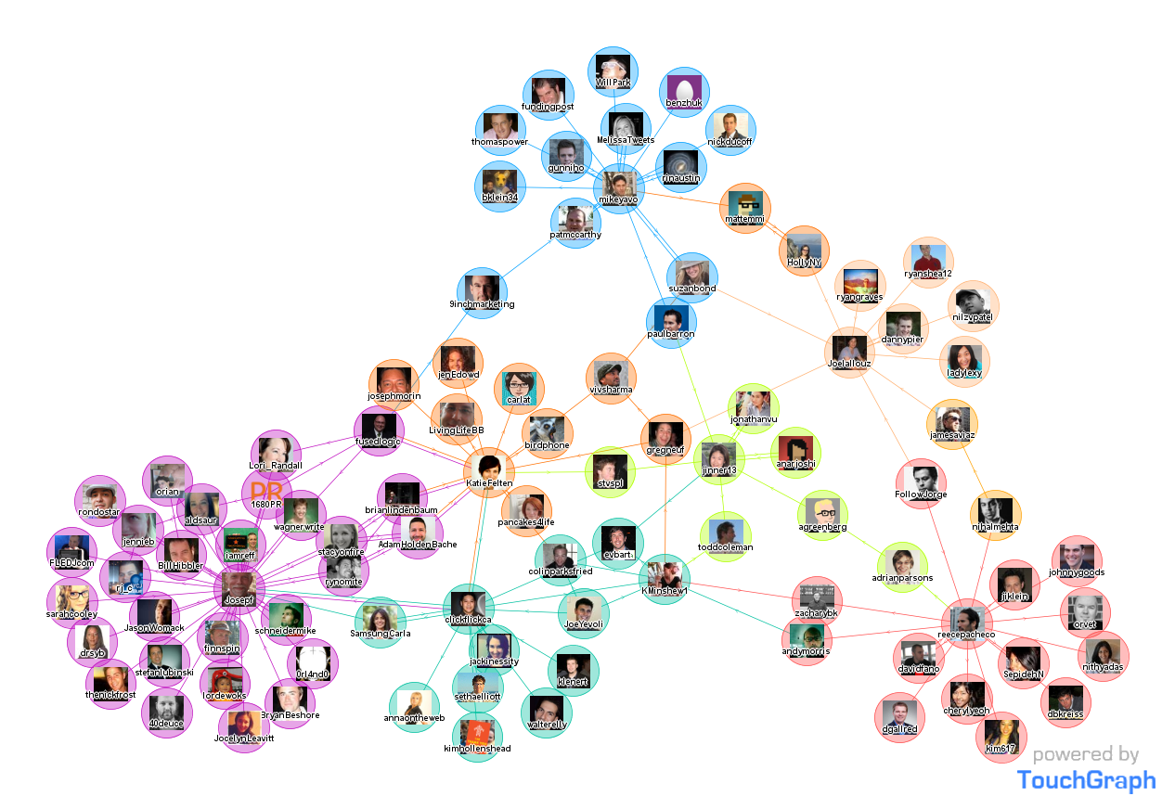
Visualization of a Social Network
Visualization of Twitter activity data

Slide 21
Graph Visualization Challenges
Graph layout and positioning
Make a concrete rendering of abstract graph
Navigation/Interaction
How to support user changing focus and moving around the graph
Scale
Above two issues not too bad for small graphs, but large ones are much tougher

Slide 22
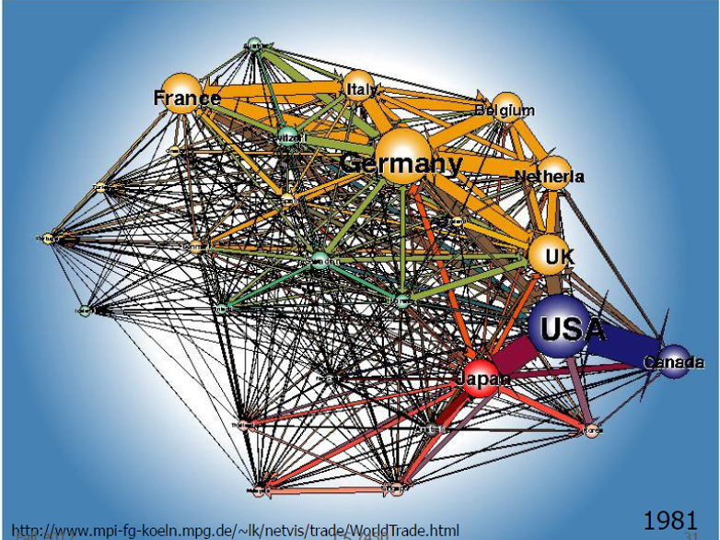
It is not easy to visualize large graphs!

Slide 23
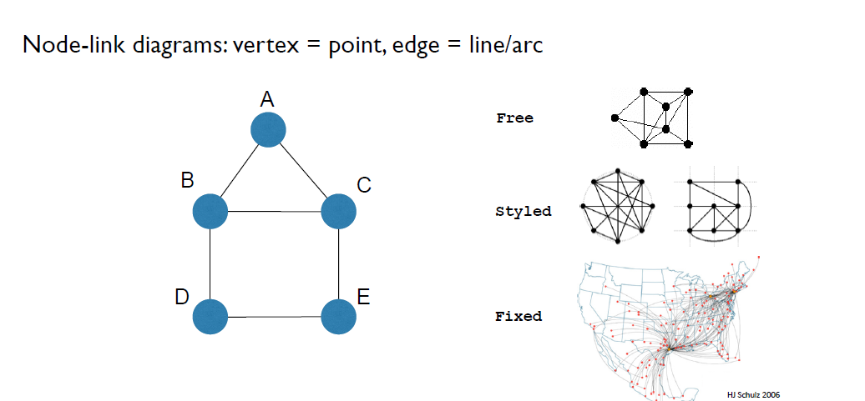
Graph Representation

Slide 24
Representation of Nodes and Links
You can use various visual attributes to encode the information of nodes and links.
Nodes
Shape
Color
Size
Label
Links
Color
Thickness
Label

Slide 25
Criteria for Good Node-Link Layout
Minimized edge crossings
Minimized distance of neighboring nodes
Minimized drawing area
Uniform edge length
Minimized edge bends
Maximized angular distance between different edges
Aspect ratio about 1 (not too long and not too wide)
Symmetry: similar graph structures should look similar

Slide 26
Criteria and Justification
Criteria | Justification
Minimise Edge Crossings | Improves readability and aids the user in following paths. Edge crossings can also conceal important information and make a graph appear less approachable to the user
Symmetry | Symmetry aids in the understanding of the structure of a graph.
Uniform Edge Lengths | For a regular structure that prevents the graph becoming distorted.
Uniform Node Distribution | For a regular structure, visual appeal and to prevent the graph feeling cluttered
Separate Non-Adjacent Nodes | Proximity implies a relationship and so adjacent nodes should appear more related than non-adjacent nodes.
Node-Edge Overlap | Avoids visual elements appearing too clustered together and ambiguity as to where the edge ends

Slide 27
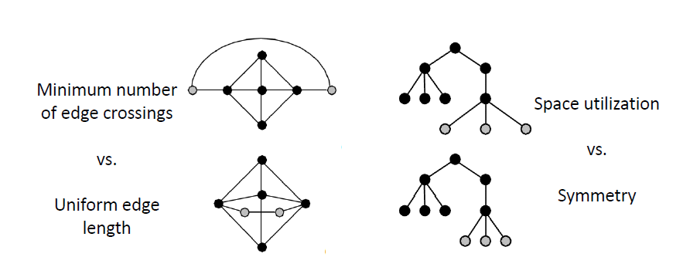
Conflicting Criteria

Slide 28
Other Criteria
Predictability
Two different runs on similar graphs should lead to similar layouts
Time Complexity
Real time interaction

Slide 29
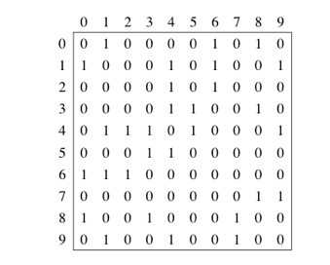
Exercise
Try to layout the graph represented by the following adjacency matrix:

Slide 30
Edge Crossing
Minimizing edge crossing is NP-hard

Slide 31
Graph - Planarity
Planar Graph
Can be drawn in the plane without crossings
Plane Graph
Planar graph with a fixed embedding

Slide 32
Smallest not-planar graphs
K₅
K_{3,3}

Slide 33
Planarity testing
Theorem [Kuratowski 1930 / Wagner 1937]
A graph G is planar if and only if it does not contain K₅ or K_{3,3} as a minor.
Minor
A graph H is a minor of a graph G, if H can be obtained from G by a series of 0 or more deletions of edges, deletions of vertices, and contraction of edges.
G = (V, E), |V| = n, planarity testing in O(n) time possible.
Notes:
Kuratoswki does not lead to efficient algorithm

Slide 34
Network Visualization
Introduction to Visualization
Graph Visualization
Graph Layout
Tree Visualization
Interaction
Network Visualization Software

Slide 35
Planar drawings
Vertices points in the plane
Edges curves
No edge crossings

Slide 36
Straightline drawings
Vertices points in the plane
Edges straight lines
Theorem
Every planar graph has a plane embedding where each edge is a straight line.
[Wagner 1936, Fáry 1948, Stein 1951]

Slide 37
Grid Layout
Vertices points in the plane on a grid
Edges polylines, all vertices on the grid
Notes:
drawing on raster devices
not too many vertices in small area

Slide 38
Grid Layout
Vertices points in the plane on a grid
Edges polylines, all vertices on the grid
Objective
minimize grid size
Notes:
drawing on raster devices
not too many vertices in small area

Slide 39
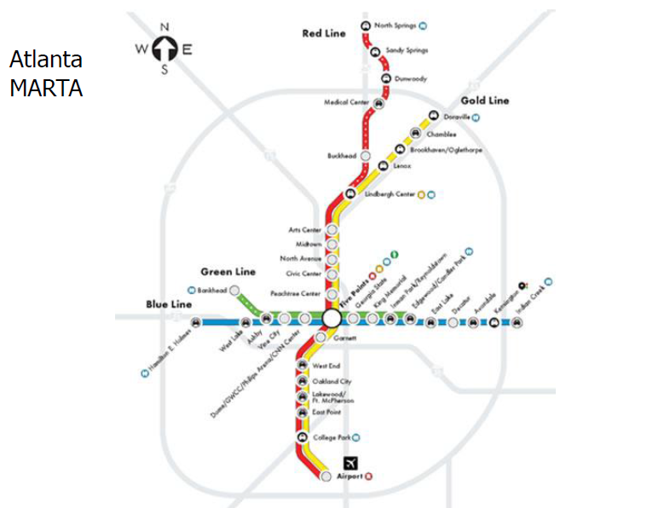
Geography-based Layout

Slide 40
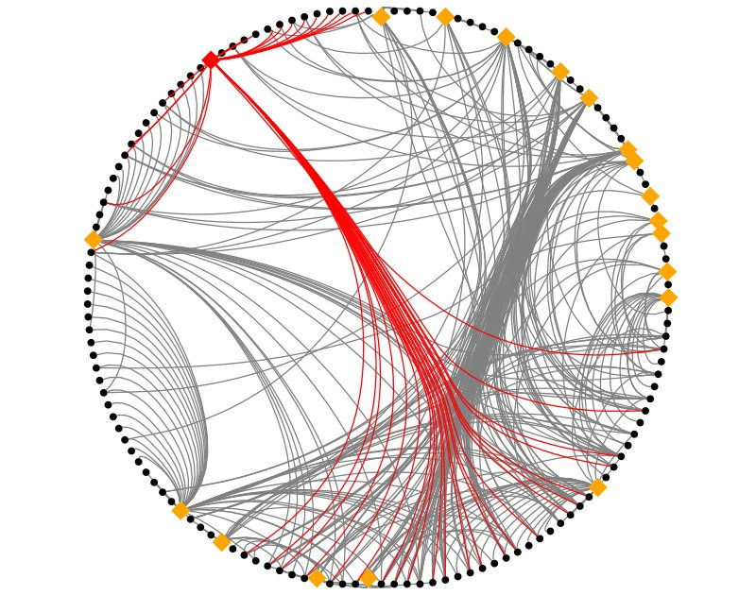
Circular Layout
Circular layout is a style of drawing that places the vertices of a graph on a circle, often evenly spaced so that they form the vertices of a regular polygon.
Draw edges to connect vertices

Slide 41
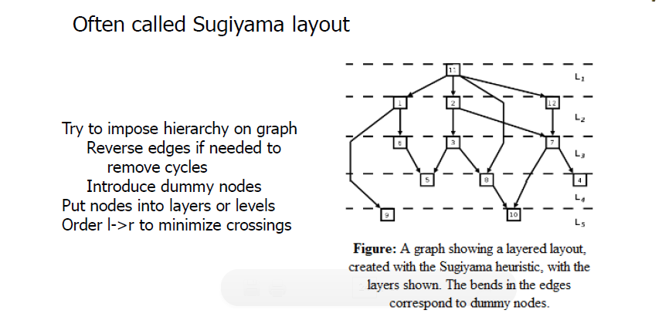
Hierarchical Layout

Slide 42
Force directed Layouts
Most common algorithmic graph drawing is based on the force-directed layput
Modelling a graph as a physical system where nodes are attracted and repelled according to some force.

Slide 43
Spring-embedded Force-directed Layout
Eades (A heuristic for graph drawing. Congressus Numerantium 1984) is the basis for almost all force-directed techniques.
Nodes are modelled as steel rings and edges as springs; the system is put into some random initial conguration and released, leaving the system to reach a stable state where the force on each node is zero.
Connected nodes are attracted to one another whilst all other nodes, modelled as electrical charges, repel
Equations for forces
Attractive force = c1 * log(d/c2)
Repulsive force = c3/d²
d is the length of the spring
c1, c2, c3 are constants
From experimentation, Eades made the decision to use springs of logarithmic strength claiming that linear strength springs were too strong
The resulting layout should have edges of uniform length and symmetry.

Slide 44
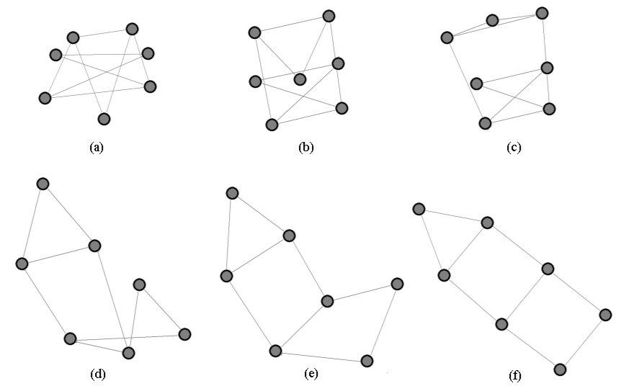
Example

Slide 45
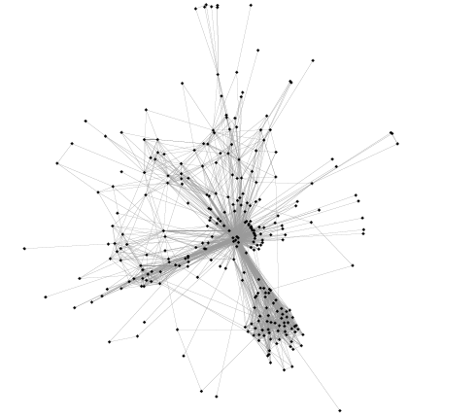
Example
The spring embedder for a protein-protein
interaction network with 283 nodes and 1749 edges

Slide 46
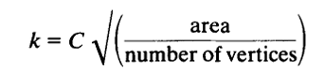
Fruchterman Reingold Algorithm (1/2)
Principle:
Vertices connected by an edge should be drawn near each other (but not too close)
Layout should have even node distribution, few edge crossings, uniform edge length, symmetry and fitting the drawingto the frame.
Forces
Attractive force = d² /k
Repulsive force = -k²/d
k: Optimum distance between vertices.
where area is the space available and C an experimentally determined constant

Slide 47
Fruchterman Reingold Algorithm (2/2)
Adds global temperature
If hot, nodes move further each step
If cool, smaller movements
Generally cools over time
The idea is that the displacement of a vertex is limited to some maximum value
This maximum value decreases over time
So, as the layout becomes better, the amount of adjustment becomes finer and finer.
The algorithm is not guaranteed to converge
Iterations of the algorithm is sufficient for an optimum layout

Slide 48
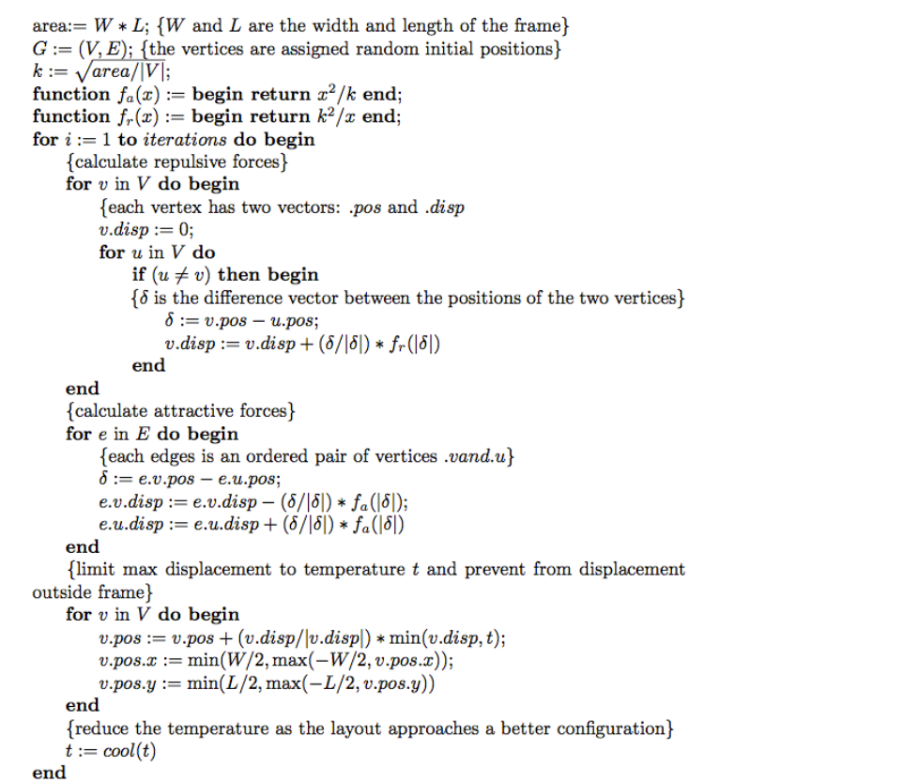
Fruchterman Reingold Algorithm - Pseudocode

Slide 49
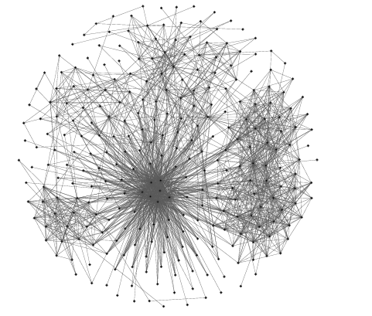
Example
The protein-protein interaction network laid out using Fruchterman and Reingold’s algorithm

Slide 50
Energy-based Approaches
Energy-based approaches consider layout to be the minima of an optimisation problem in which an energy function encodes the desired properties of the graph.
Example: Force Atlas 2014 https://doi.org/10.1371/journal.pone.0098679
Main aim is to highlight clustering in a graph
Uses linear attractive and repulsive forces.
Attractive forces are distances between nodes
Repulsive forces are also based on distances
This ensures all nodes have at least some repulsive force reducing visual clutter.
The algorithm maximises speed until it is clear that some nodes are unstable at which point it slows and emphasizes precision.
The layout is interactive for the user
There are many options that can be configured even while the layout is running to produce a layout that is most suitable for the user

Slide 51
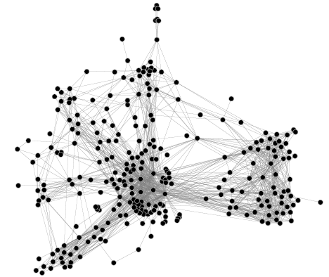
Example
The protein-protein interaction network laid out using Force Atlas algorithm

Slide 52
Force-directed Layouts – Evaluation
Pros
Strong theoretical foundations
Simplicity: Few lines of code
Good results (till graphs of about 1000 nodes)
Works well with structures such as grids, trees and sparse graphs rather than those with a dense structure.
Cons
Computationally expensive
Often produces poor layouts for large graphs
Time complexity O(|V|² + |E|)
For interactive visualization limit is about 1000 nodes
Not predictable

Slide 53
Computational Improvements - Multi-level Techniques
Find a sequence of coarser representations of a graph
The coarser representations are created by collapsing connected nodes whose edges becomes the union of the edges of all the nodes it comprises
Optimise the drawing in the coarsest representation, and propagate that layout back through to the original graph
Example: Hu Y [2005]

Slide 54
Yifan Hu Algorithm
Follows a simple edge collapsing coarsening scheme
If more than 50% of the nodes remain after the edge collapsing then the algorithm uses maximum independent vertex sets (MIVS) for their coarsening procedures
An IVS is formed if there are no two nodes connected by an edge in the subset
It is said to be maximal if the addition of any edge to the subset would break this property
Uilises the Barnes-Hut approximation
A square is placed over the initial layout of the graph and is divided into four.
If there is more than one node inside a sub-square then it is divided into four.
This procedure continues recursively until each square contains at most one node.
Nodes are then clustered based on their position in the quad-tree
Those clusters considered to be far from the node of interest form a super-node whose forces can be considered as one reducing the complexity of the force calculation.
Improves the order of complexity of the calculation from O(n2) to O(n log n).
Adds an adaptive cooling scheme to a general force-directed model
Step length remains constant until there are consecutive energy reductions, in which case the step size is increased, or
If there is an energy increase then step length is decreased

Slide 55
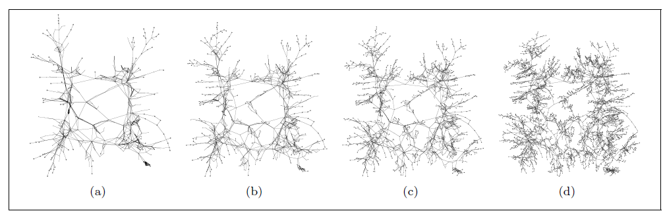
Example
Each image from left to right shows the layout propagated back up through each less coarse version of the graph,
i.e., (a) is the most coarse version of the graph while (d) is the final layout.

Slide 56
Dimensionality Reduction
Dimension reduction is the process of taking data expressed in high-dimensional space and projecting it onto a lower-dimensional space.
The challenge is to try to retain the information that is in the high-dimensional space and capture it in the lower-dimensional representation.
Most dimension reduction techniques currently used for graph layout use the graph-theoretic distance between a pair of nodes as the information that is to be preserved.
2 common techniques for Dimension reduction:
Principal Component Analysis (PCA)
Multidimensional Scaling

Slide 57
Principal Component Analysis (PCA)
Principal Component Analysis (PCA) is a linear dimensionality reduction technique that can be utilized for extracting information from a high-dimensional space by projecting it into a lower-dimensional sub-space.
It tries to preserve the essential parts that have more variation of the data and remove the non-essential parts with fewer variation.
When the data is projected into a lower dimension (assume three dimensions) from a higher space, the lower dimensions are nothing but the Principal Components that captures most of the variance of the data.
Principal components have both direction and magnitude. The direction represents across which principal axes the data is mostly spread out or has most variance and the magnitude signifies the amount of variance that Principal Component captures of the data when projected onto that axis.
The principal components are a straight line, and the first principal component holds the most variance in the data.
Each subsequent principal component is orthogonal to the last and has a lesser variance.

Slide 58
High-dimensional Embedding (HDE)
The aim of this layout was to follow the convention of placing adjacent nodes close together and non-adjacent nodes further apart.
The graph is first embedded in a high-dimensional space by choosing 50 nodes as pivots and associating each pivot with a dimension
Nodes are then expressed in high-dimensional space as graph-theoretic distances from pivots.
Then the graph is linearly projected onto two dimensions using PCA.
HDE is one of the quickest layout techniques available
Harel D and Koren Y, Graph drawing by high-dimensional embedding. Journal of Graph Algorithms and Applications 2004

Slide 59
Multidimensional Scaling
MDS is a non-linear technique for embedding data in a lower-dimensional space
It maps points residing in a higher-dimensional space to a lower-dimensional space while preserving the distances between those points as much as possible.
Because of this, the pairwise distances between points in the lower-dimensional space are matched closely to their actual distances.

Slide 60
Pivot MDS
In Pivot MDS some nodes are assigned to be pivots
The first pivot is chosen randomly and subsequent ones are chosen by being the node with the greatest graph-theoretic distance from all selected pivots so far).
Non-pivots are positioned based on their distances to the pivot nodes
The pivot nodes can use the distances both to other pivot nodes and non-pivot nodes to determine their position.
Brandes U and Pich C, Eigensolver methods for progressive multidimensional scaling of large data, in: Kaufmann M and Wagner D (eds.) Graph Drawing, Lecture Notes in Computer Science, volume 4372, 2007.

Slide 61
Using Node Attributes for Layout
Attributes of nodes influence geometric positioning
Example: Scatter plot based on node values
Not just some arbitrary layout - Utilize graph statistical analysis
There are three main ways attributes can be used in graph layout:
use them to impose a set of restrictions on the placement of nodes
use membership of a group or cluster to position the nodes
directly map an attribute (or attributes) to a coordinate in the layout space (e.g., x and y in a Cartesian system).

Slide 62
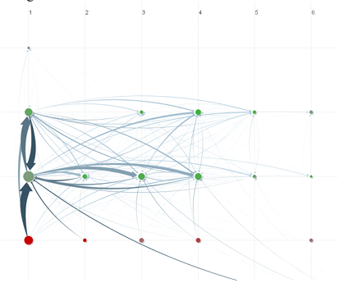
Pivot Graph
Cluster on common node attributes
Put all A’s together, all B’s together, …
Position nodes into a grid based on attributes
Draw edge from A to B depending on how many edges from some A to some B
Problems:
Only 2 variables
Doesn’t support continuous variables
Wattenberg CHI ‘06
Communication network of people in a large company. X-axis is division, y-axis is office geography. The division in the leftmost column has far more cross-location communication than the others.

Slide 63
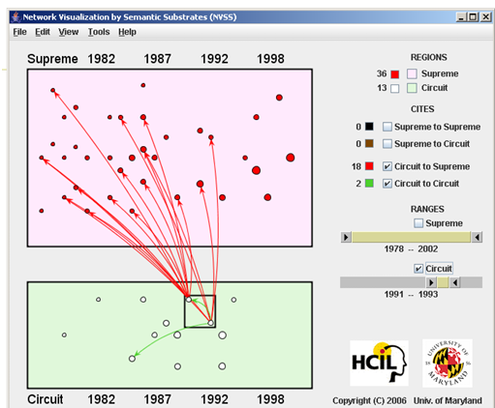
Network Visualization by Semantic Substrates (NVSS)
Group nodes into regions according to an attribute
Categorical, ordinal, or binned numerical
In each region: Position nodes according to some other attribute(s)
Give users control of link visibility
Shneiderman & Aris TVCG (InfoVis) 2006
Cases are first grouped into Supreme Court and Circuit Court. Positioned based on year.
Selecting 2 Circuit Court cases in 1991-1993 generates a comprehensible display of the 18 red Supreme Court and the 2 green Circuit Court citations.

Slide 64
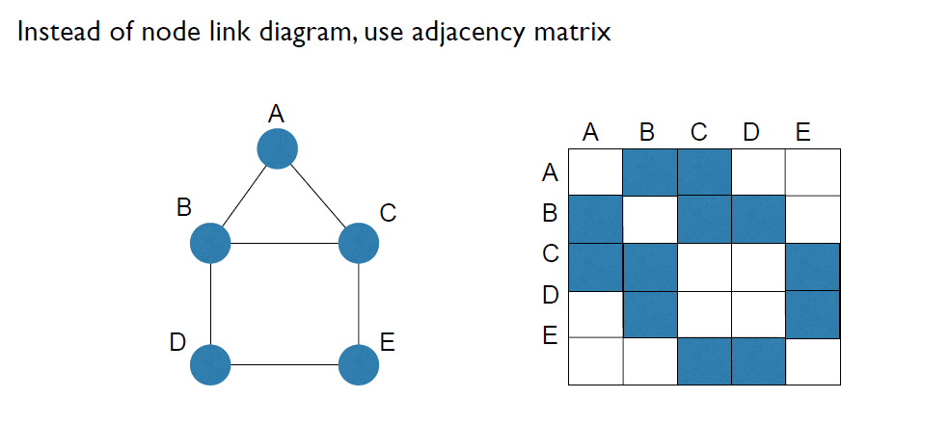
Matrix Representation

Slide 65
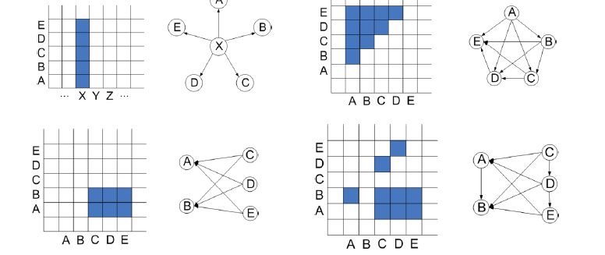
Examples

Slide 66
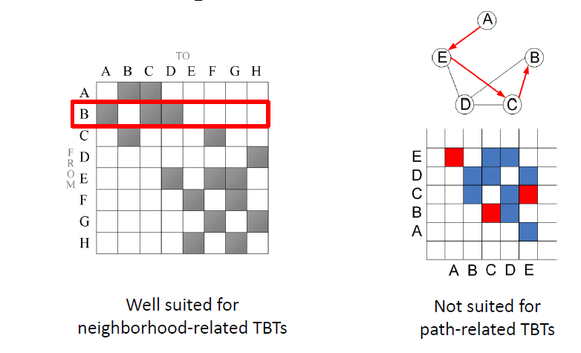
Pros and Cons

Slide 67
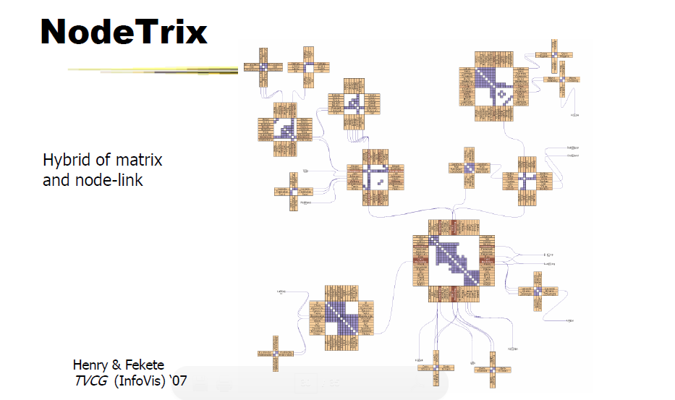

Slide 68
Using Machine Learning for Graph Layout
Machine Learning techniques have been extensively employed to generate graph drawings that mimic the layout styles of given graph drawing examples.
O. Kwon et al., “What would a graph look like in this layout? a machine learning approach to large graph visualization,” IEEE TVCG, 2018
Presented an ML approach to facilitate large graph visualization by learning the topological similarity between large graphs.
Specifically, the method provides a quick overview of visualizations for an input large graph data by learning from the drawings with similar topology structures.
This approach is further extended in [O. Kwon and K. Ma, “A deep generative model for graph layout,” IEEE TVCG, 2020]
Learns the layout from examples using a deep generative model.
The model is then used to provide users with an intuitive way to explore the layout design space of the input data.

Slide 69
Machine Learning for Graph Layout - DeepGD
DeepGD can generates graph layouts complying with multiple aesthetic metrics simultaneously
It can be applied easily to optimize most of the commonly agreed aesthetic metrics.
Also, DeepGD only needs to be trained once
A Convolutional Graph Neural Network (ConvGNN) is used to produce the position of nodes such that the desired aesthetic metrics are optimized in the resulting layout.
To accomplish this goal, a multi-objective loss function is designed in a way that each of the aesthetic aspects is represented by an individual component in the composite loss function.
Additionally, two adaptive training strategies are proposed to automatically adjust the weight factors corresponding to each loss component such that the human preference on aesthetics trade-off is reflected in the weight factors.
Xiaoqi Wang, Kevin Yen, Yifan Hu and Han-Wei Shen. DeepGD: A Deep Learning Framework for Graph Drawing Using GNN. IEEE Computer Graphics and Applications, 2021

Slide 70
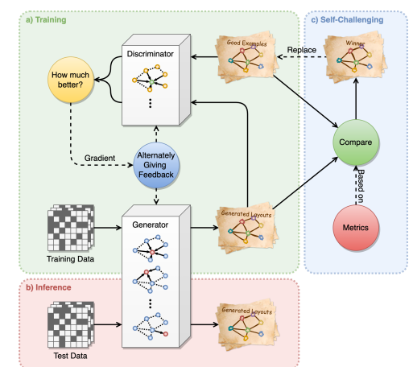
Machine Learning for Graph Layout - SmartGD
SmartGD is a novel Generative Adversarial Network (GAN) based deep learning framework for graph drawing.
The system can optimize different quantitative aesthetic goals like minimizing stress, minimizing edge crossing, maximizing crossing angle, as well a combination of multiple aesthetics.
The high-level overview of SmartGD:
The training procedure of the GAN-based model.
Describes the inference procedure for drawing unseen graph.
The self-challenging mechanism is applied only when the optimization criterion is given to learn better quality layouts than the collected examples.

Slide 71
Readings
H. Gibson, J. Faith, and P. Vickers, “A survey of two-dimensional graph layout techniques for information visualisation,” Information Visualization, vol. 12, no. 3-4, pp. 324–357, 2013. https://journals.sagepub.com/doi/pdf/10.1177/1473871612455749
Fruchterman and Reingold. Graph Drawing by Force-directed Placement. Software - Practice and Experience, 1991 Available at: http://reingold.co/force-directed.pdf
Hu Y, Efficient, high-quality force-directed graph drawing. Mathematica Journal 2005; 10:37-71 https://www.researchgate.net/publication/235633159_Efficient_and_High_Quality_Force-Directed_Graph_Drawing
Harel D and Koren Y, Graph drawing by high-dimensional embedding. Journal of Graph Algorithms and Applications 2004; 8: 207-219.
M. Wattenberg, Visual exploration of multivariate graphs, Proceedings of ACM CHI 2006, Available at: http://hint.fm/papers/pivotgraph.pdf
Henry and Fekete: NodeTrix: A Hybrid Visualization of Social Networks. IEEE Transactions on Visualization and Computer Graphics, 2007. Available at: https://www.microsoft.com/en-us/research/wp-content/uploads/2016/12/Henry_infovis07.pdf
Xiaoqi Wang, Kevin Yen, Yifan Hu and Han-Wei Shen. SmartGD: A GAN-Based Graph Drawing Framework for Diverse Aesthetic Goals. IEEE transactions on visualization and computer graphics, 2022

Slide 72
Network Visualization
Introduction to Visualization
Graph Visualization
Graph Layout
Tree Visualization
Interaction
Graphical Excellence
Network Visualization Software

Slide 73
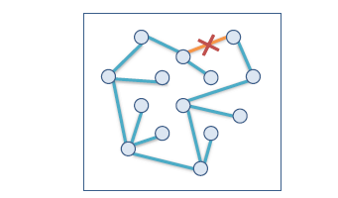
Tree
A tree is a hierarchical structure with a set of connected nodes.
Nodes have a parent and zero or more children
Root: Node with no parent (the top-most node in the tree hierarchy)
Leaves: Nodes with no children
A Tree is a graph with no cycles
Each child can be treated like the root node of its own subtree (recursive structure)
Many occurrences in the real world:
File/directory systems on computers
Organization charts
Animal kingdom: Phylum,…, genus,…
Object-oriented software classes

Slide 74
Tasks
Describe/understand structure
Find items
What are the parent/children/siblings of x?
Where is this subtree?
Where are nodes with particular values located?
What kind of attributes does this subtree have?

Slide 75
Tree Visualization Approaches
Node and Link
Space Filling

Slide 76
Tree Visualization Approaches
Node and Link
Space Filling

Slide 77
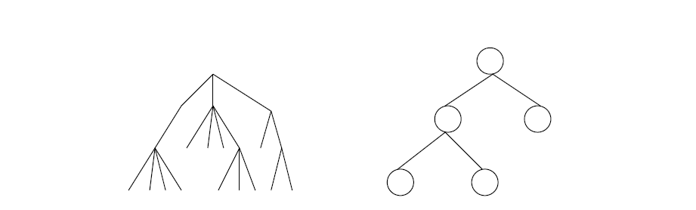
Node link diagram
Root at top, leaves at bottom is very common

Slide 78
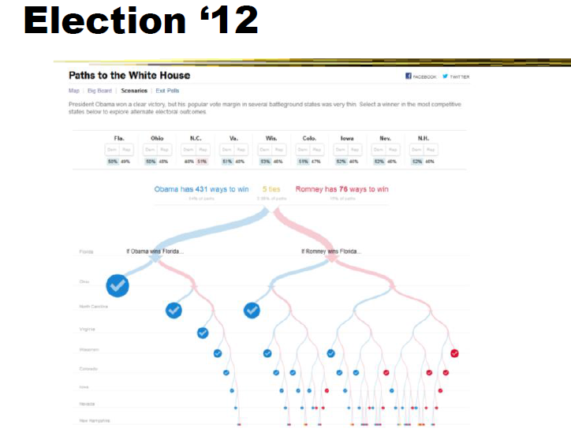

Slide 79
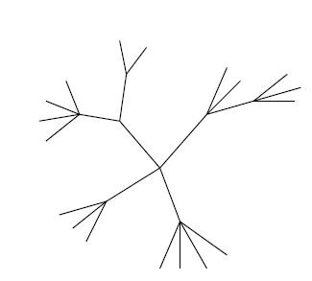
Radial Layout
Root can be at center with levels growing outward too

Slide 80
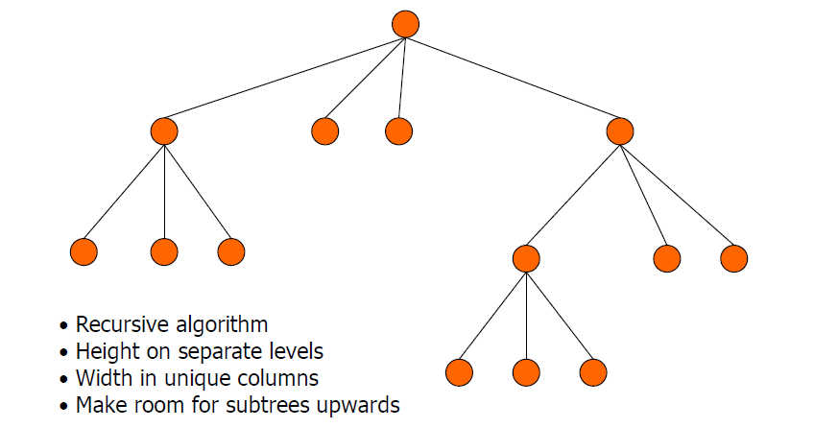
Basic Algorithm
Repeatedly divide space for subtrees by leaf count
Breadth of tree along one dimension
Depth along the other dimension

Slide 81
Potential Problems
For top-down, width of fan-out uses up horizontal real estate very quickly
At level n, there are 2n nodes
Tree might grow a lot along one particular branch
Hard to draw it well in view without knowing how it will branch

Slide 82
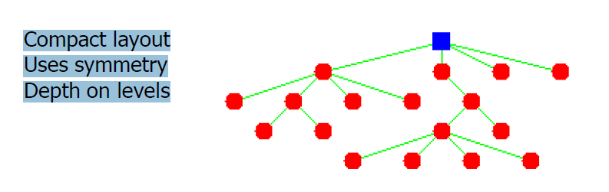
Reingold-Tilford Algorithm
Linear algorithm
Starts with bottom-up pass of the tree
Y-coord by depth, arbitrary starting X-coord
Merge left and right subtrees
Shift right as close as possible to left
Computed efficiently by maintaining subtree contours
“Shifts” in position saved for each node as visited
Parent nodes are centered above their children
Top-down pass for assignment of final positions
Sum of initial layout and aggregated shifts

Slide 83
3D Techniques
Add a third dimension into which layout can go
Benefits
“Gaining more space”
Human familiarity with 3D

Slide 84
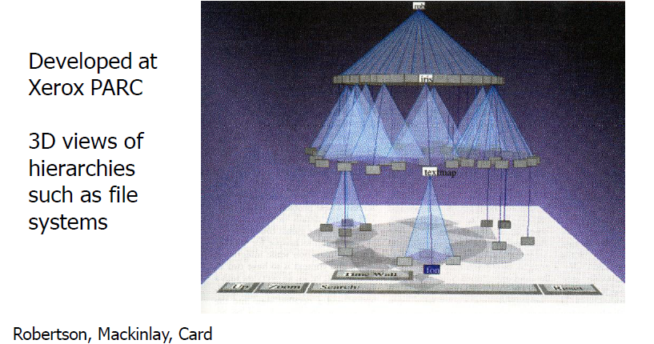
Cone Tree
Children of a node are laid out in a cylinder “below” the parent Siblings live in one of the 2D planes

Slide 85
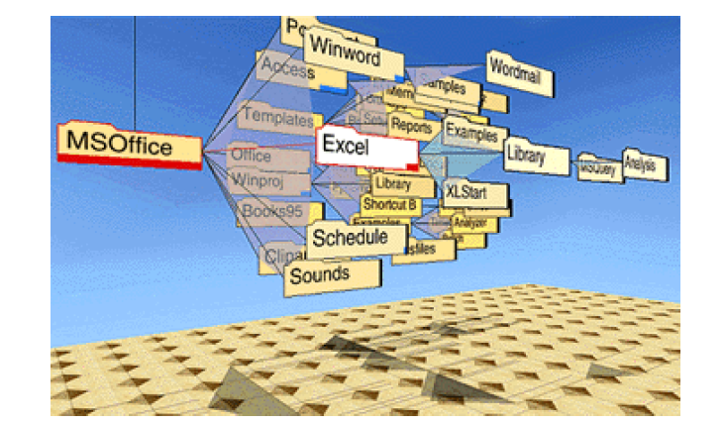
Alternate View

Slide 86
Cone Tree - Evaluation
Pros
More effective area to lay out tree
Use of smooth animation to help person track updates
Aesthetically pleasing
Cons
As in all 3D, occlusion obscures some nodes
Non-trivial to implement and requires some graphics horsepower

Slide 87
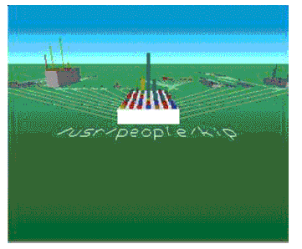
Fly-Through of 2D Representation
SGI File System Navigator
Size represents file size

Slide 88
Tree Visualization Approaches
Node and Link
Space Filling

Slide 89
Node-Link Shortcoming
Difficult to encode more variables of data cases (nodes)
Shape
Color
Size
…but all quickly clash with basic node-link structure

Slide 90
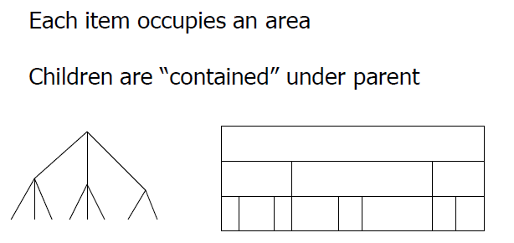
Space Filling Representation

Slide 91
Treemap
Space-filling representation developed by Shneiderman and Johnson, Vis ‘91
Children are drawn inside their parent
Alternate horizontal and vertical slicing at each successive level
Use area to encode other variable of data items

Slide 92
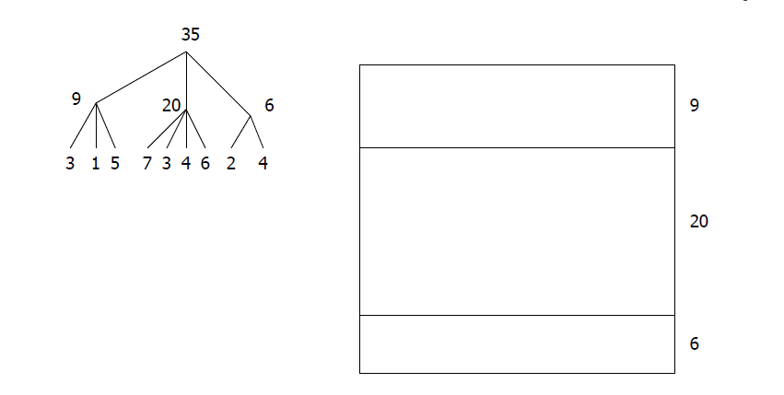
Example

Slide 93
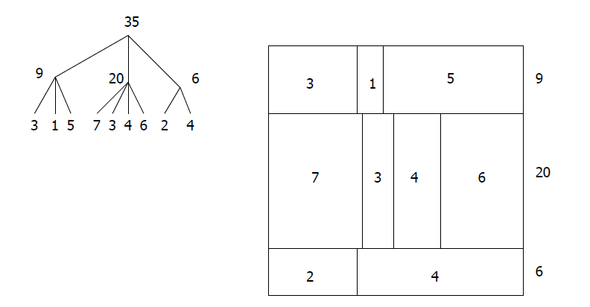
Example

Slide 94
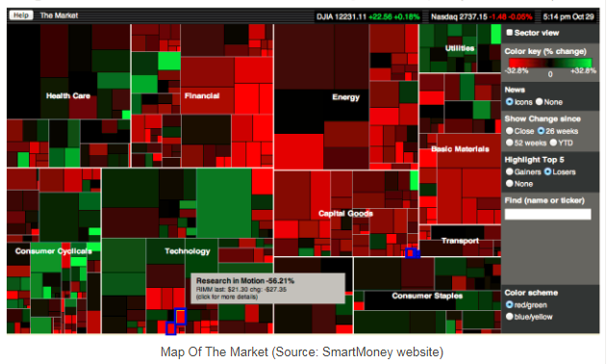
Example - Finance

Slide 95
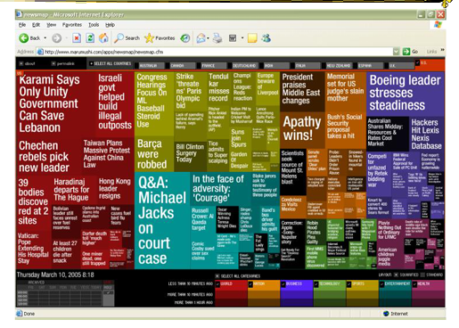
Example - News

Slide 96
Treemap - Algorithm
Draw() {
Change orientation from parent (horiz/vert)
Read all nodes at this level
Make rectangle for each, scaled to size
Draw rectangles using appropriate size and color
For each directory
Make recursive call using its rectangle as focus
}

Slide 97
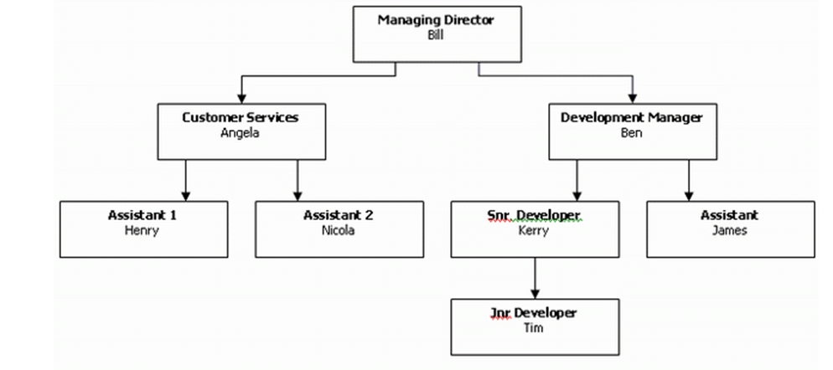
Exercise
Draw a treemap view of the following:

Slide 98
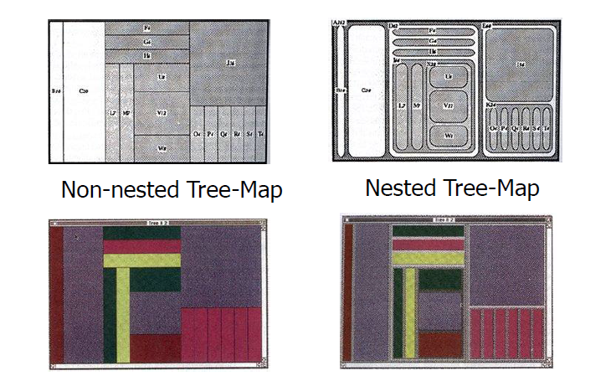
Nested vs Non-nested

Slide 99
Treemap - Evaluation
Good representation of two attributes beyond node-link: color and area
Not as good at representing structure
What happens if it’s a perfectly balanced tree of items all the same size?
Also can get long-thin aspect ratios
Borders help on smaller trees, but take up too much area on large, deep ones

Slide 100
Showing Structure
Regular borderless treemap makes it challenging to discern structure of hierarchy, particularly large ones
Supplement Treemap view
Change rectangles to other forms

Slide 101
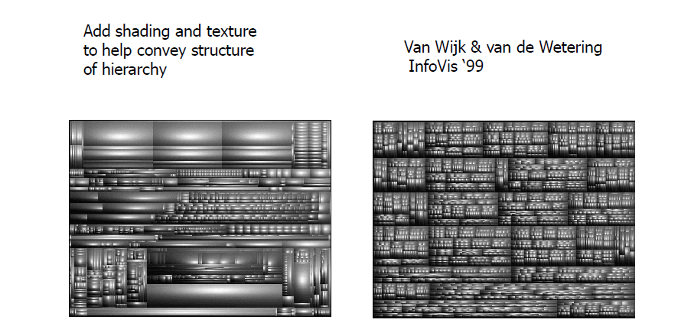
Cushion Treemap

Slide 102
Context Treemaps
What if nodes with zero value (mapped to area) are very important?
Example: Stock or mutual fund portfolios: Funds you don’t currently hold have zero value in your portfolio, but you want to see them to potentially buy them
Context Treemap: Treemap with small distortion
Give zero-valued items (all together) some constant proportion of screen area
Provide dynamic query capabilities to enhance exploration leading to portfolio diversification

Slide 103
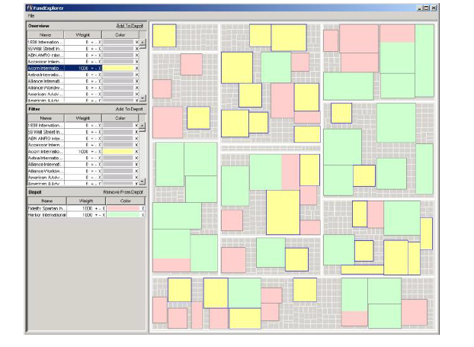
Fund Explorer
Show mutual fund portfolios, including funds not currently held
Area maps to your relative investment in fund
Want to help the user with portfolio diversification as well
If I add fund X, how does that overlap with my current fund holdings?
Csallner, Handte, Lehmann & Stasko, InfoVis 2003

Slide 104
Another Technique
What if we used a radial rather than a rectangular space-filling technique?
We saw node-link trees with root in center and growing outward already...
Make pie-tree with root in center and children growing outward
Radial angle now corresponds to a variables rather than area

Slide 105
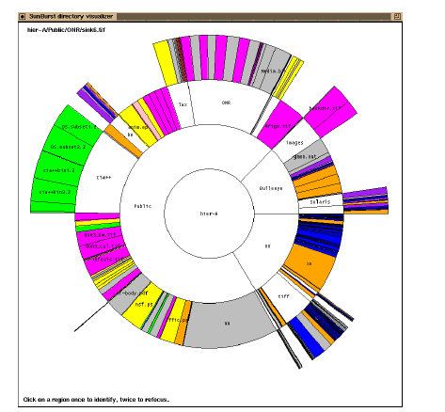
Sunburst
Root directory at center, each successive level drawn farther out from center
Sweep angle of item corresponds to size
Color maps to file type or age
Interactive controls for moving deeper in hierarchy, changing the root, etc.
Double-click on directory makes it new root
Stasko and Zhang, Infovis 2000

Slide 106
Node-link or Space filling?
Node-link typically better at exposing structure of information structure
Space-filling good for focusing on one or two additional variables of cases

Slide 107
Reading
Fruchterman and Reingold. Graph Drawing by Force-directed Placement. Software - Practice and Experience, 1991 Available at: http://reingold.co/force-directed.pdf
Reingold and Tilford: Tidier Drawings of Trees Available at: http://reingold.co/tidier-drawings.pdf
Robertson, Mackinlay and Card: Cone Trees: Animated 3D visualizations of Hierarchical Information Available at: http://www2.parc.com/istl/groups/uir/publications/items/UIR-1991-06-Robertson-CHI91-Cone.pdf
Johnson and Shneiderman: Tree Visualization with Tree-maps: 2-d space-filling approach Available at: https://www.cs.umd.edu/users/ben/papers/Johnson1991Tree.pdf
Stasko and Zhang. Focus+Context Display and Navigation Techniques for Enhancing Radial, Space-Filling Hierarchy Visualizations. Infovis 2000. Available at: https://faculty.cc.gatech.edu/~john.stasko/papers/infovis00.pdf

